Slide 1

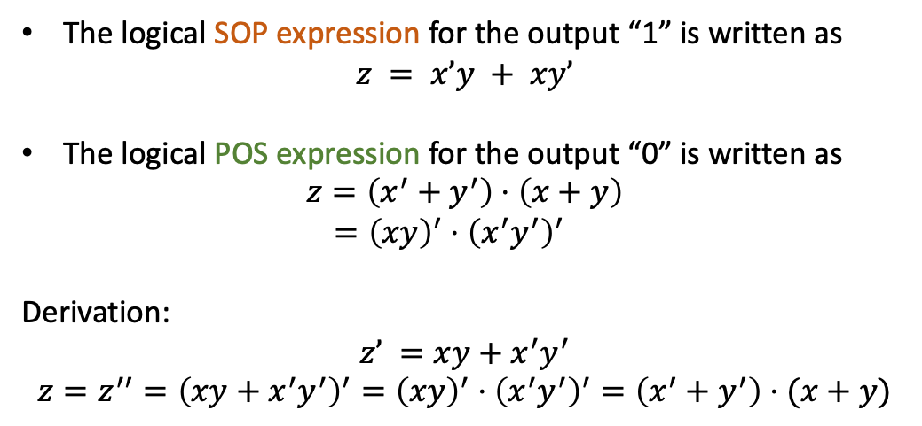

真值表的布尔表达式求法 Boolean expression for truth table
Sum-of-products (SOP)
Product-of-sum (POS)
x | y | z = x^y | z’
0 | 0 | 0 | 1
0 | 1 | 1 | 0
1 | 0 | 1 | 0
1 | 1 | 0 | 1
真值表 Truth table
The logical SOP expression for the output “1” is written as
$$z = x’y + xy’$$
The logical POS expression for the output “0” is written as
$$z=\left(x^{′}+y^{′}\right)⋅\left(x+y\right)$$
$={\left(xy\right)}^{′}⋅{\left(x^{′}y^{′}\right)}^{′}$
Derivation:
$$z’ =xy+x^{′}y^{′}$$
$$z=z^{′′}={\left(xy+x^{′}y^{′}\right)}^{′}={\left(xy\right)}^{′}⋅{\left(x^{′}y^{′}\right)}^{′}=\left(x^{′}+y^{′}\right)⋅(x+y)$$
$$\left(\sim x\&y\right)| (x\&\sim y)$$
$$\left(\sim \left(x\&y\right)\right) \& (\sim \left(\sim x\&\sim y\right))$$

